Slide 1
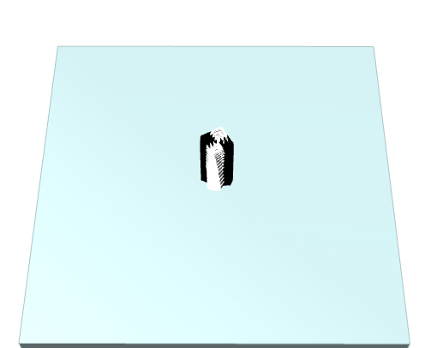
P1
<Computational Design Thinking>
<Generative Design>
P1
Assignment
Context
Course
Date
Parametric
Design
Freshmore
Term 1
Computational
Design Thinking
2023
Student
<Description>
My parametric design is based on the Fibonacci sequence. From the increasing squares inside each rectangle to the spirals that increases in distance from the centre of my design, it is derived on the golden ratio of the Fibonacci sequence to create its shape. Due to the golden ratio of the Fibonacci sequence, the spirals coincide at different phases to form different shapes such as the taijitu shape or an octopus shape. Symmetries are also created due to the golden ratio.
The sine function is used to create the rippling effects of my design while also imitating the Fibonacci sequence through the expanding and concentric nature of a ripple.
Song Wei Jie Eddy
1007957
Instructor
Geraldine Quek
Instructor

Slide 2
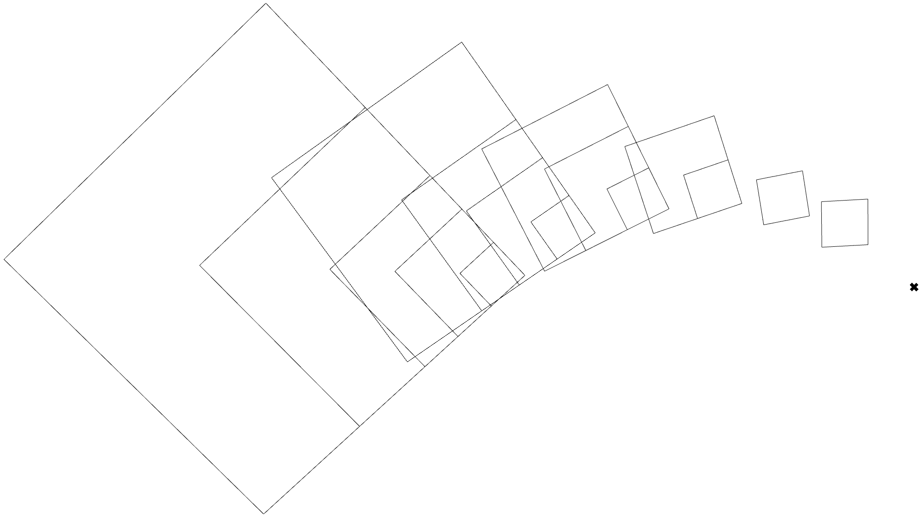
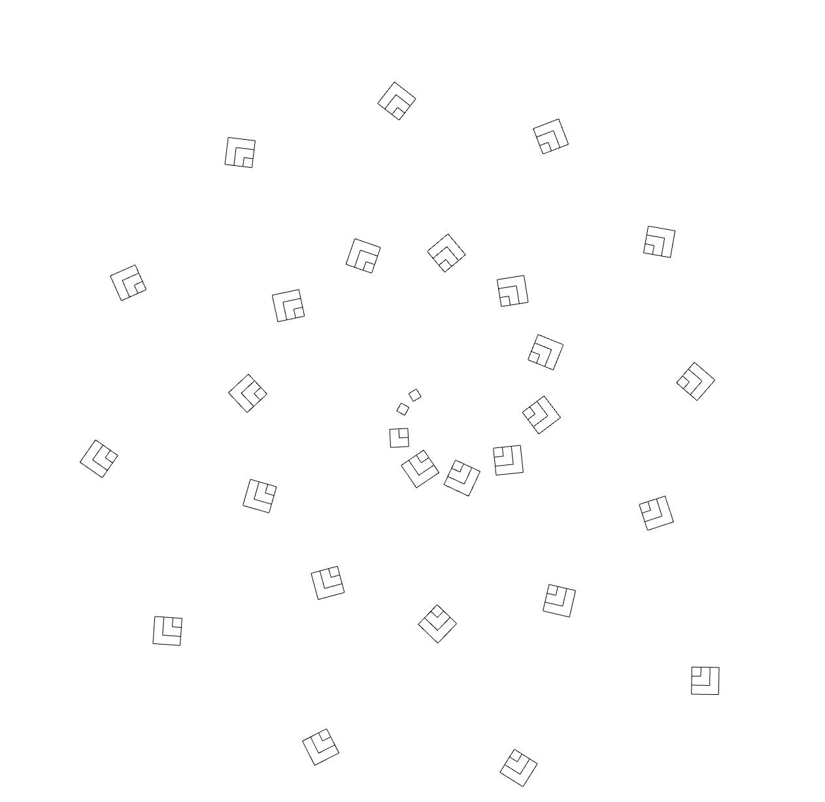
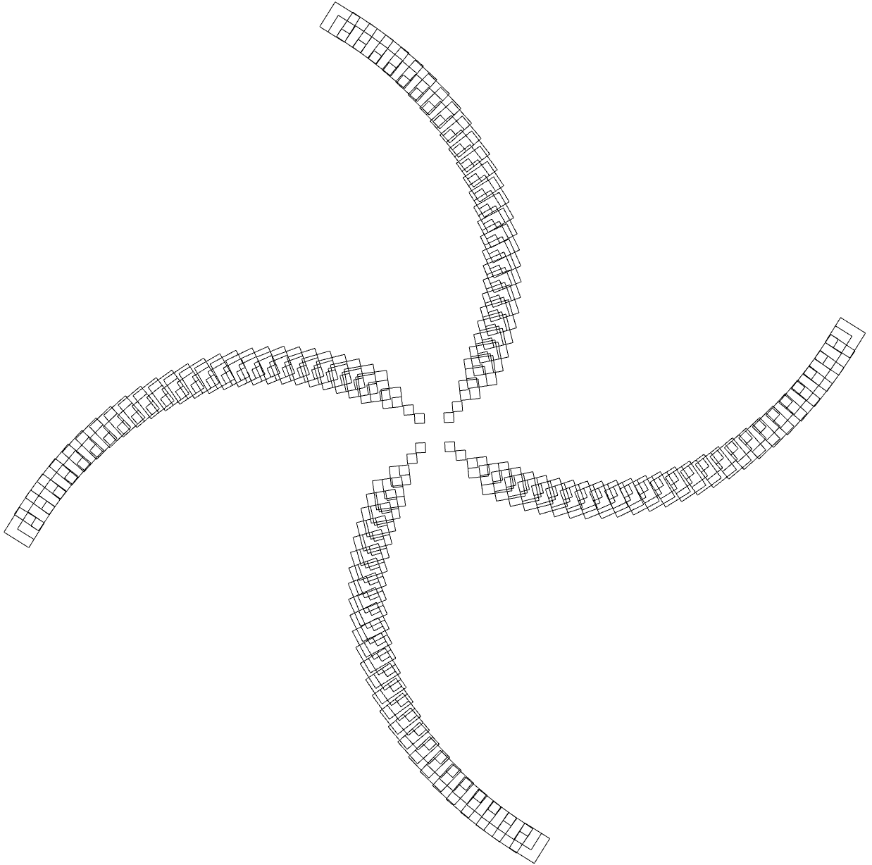
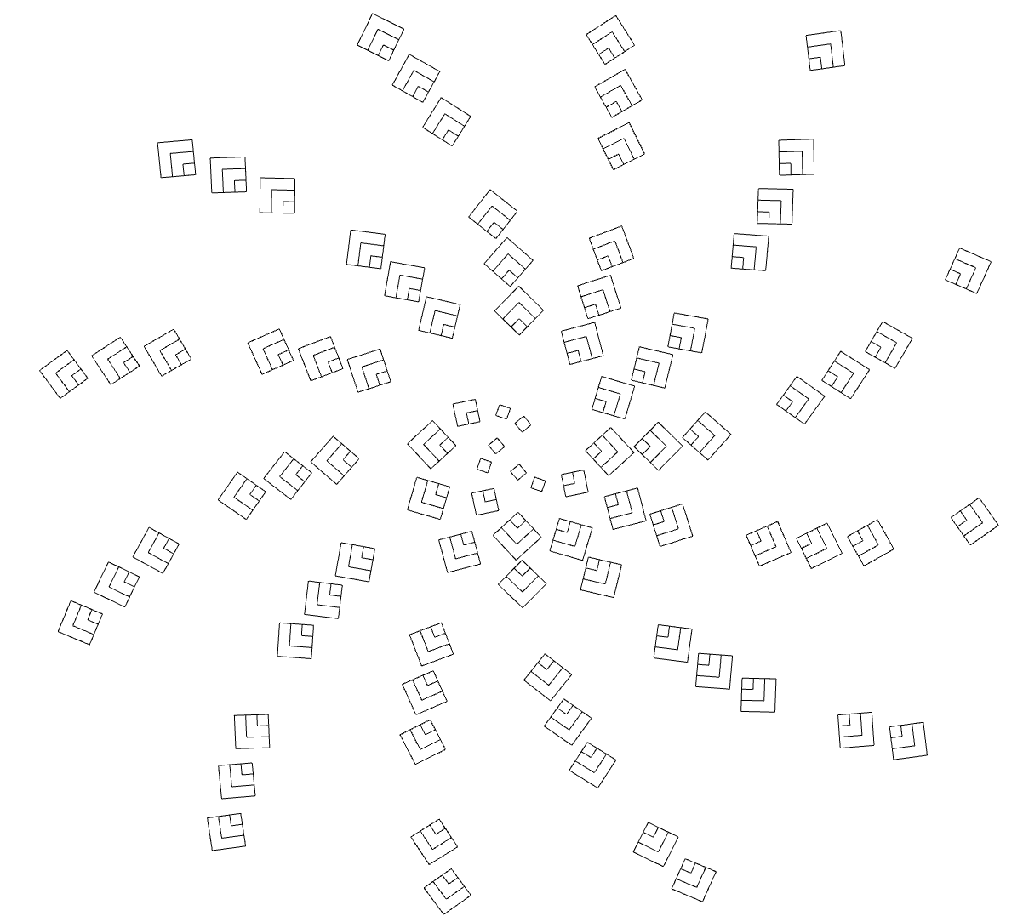
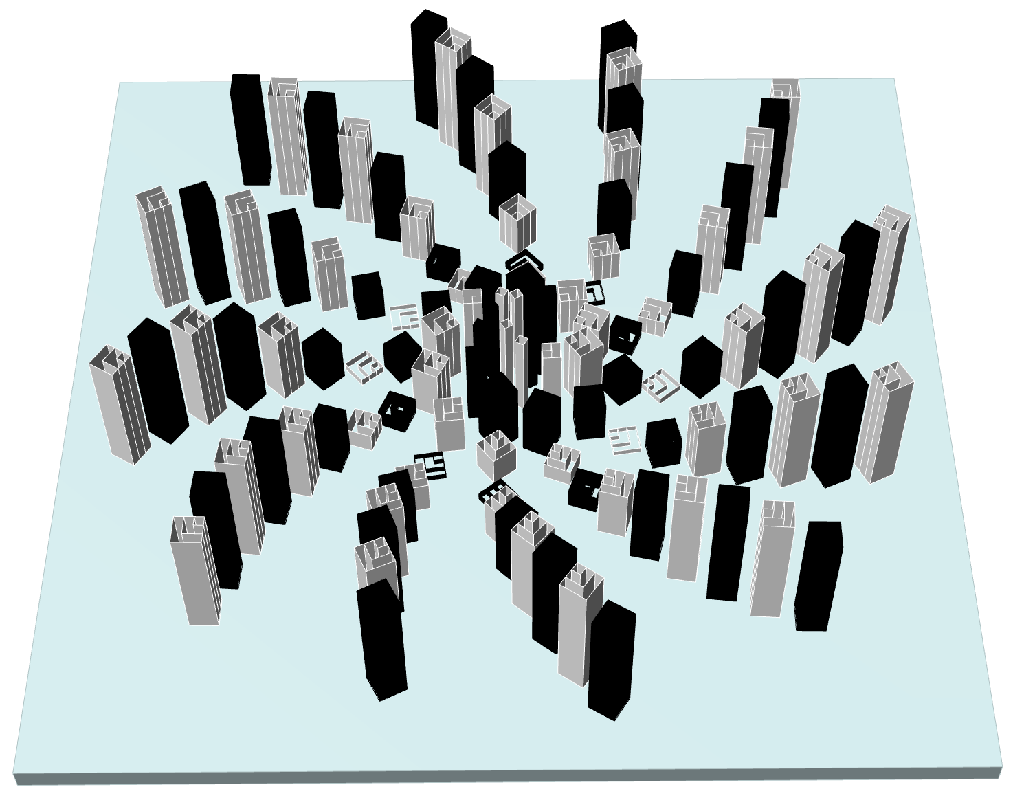
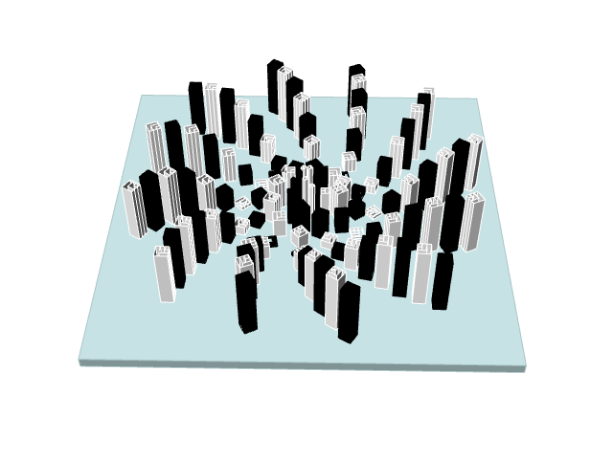
P2
<Computational Design Thinking>
<Generative Design>
P2
References
References
<Process of Design>
The pictures in this slide also shows the progression of my design from the initial stages of my parametric design to the final design.
I used the Fibonacci sequence for its recursive function so that I could create the spirals that form my design. Fibonacci sequence also created squares of differing lengths inside of each other as seen in 1st picture. However, in the final design, I limited the maximum number of squares it can form increases to 3 to fit the dimensions of my square base.
<Consideration and optimisation>
Throughout the designing process, I had to create several limits to the maximum number of my parameters as firstly the Fibonacci sequence often results in the design getting bigger exponentially. Secondly, the optimisation of my design is so that the outcome of the design will not have unnecessary features while still conveying the design aspect of my parametric design. Lastly, it reduces the usage of the materials when printing as well as reducing printing time. A square base was created in order help maintain the structural integrity of my design during printing.
Captions
01 Expanding squares inside of each other
02 The first spiral
03 Creating multiple spirals
04 Final design
05 Final design with extrusion
06 Rippling effect of the sine function
01
02
03
04
05
06

Slide 3
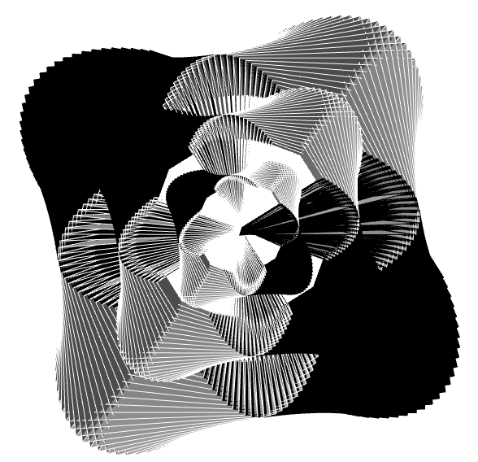
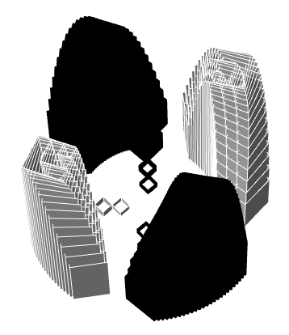
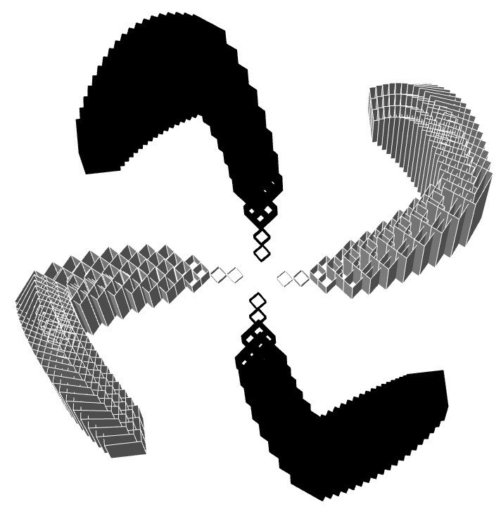
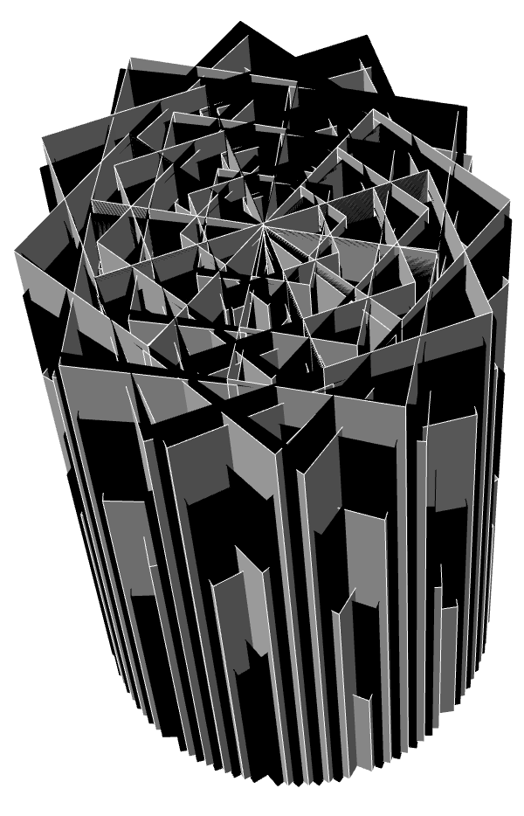
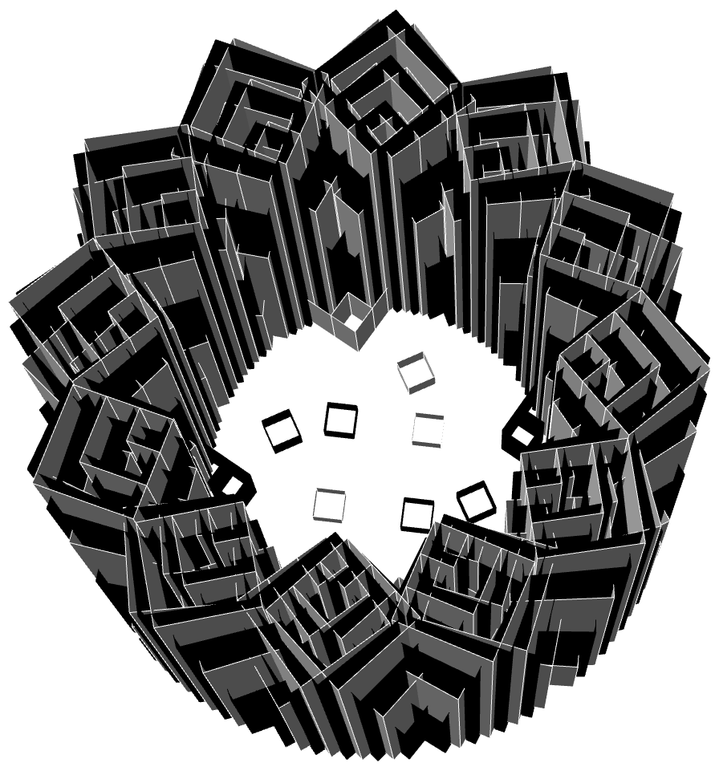
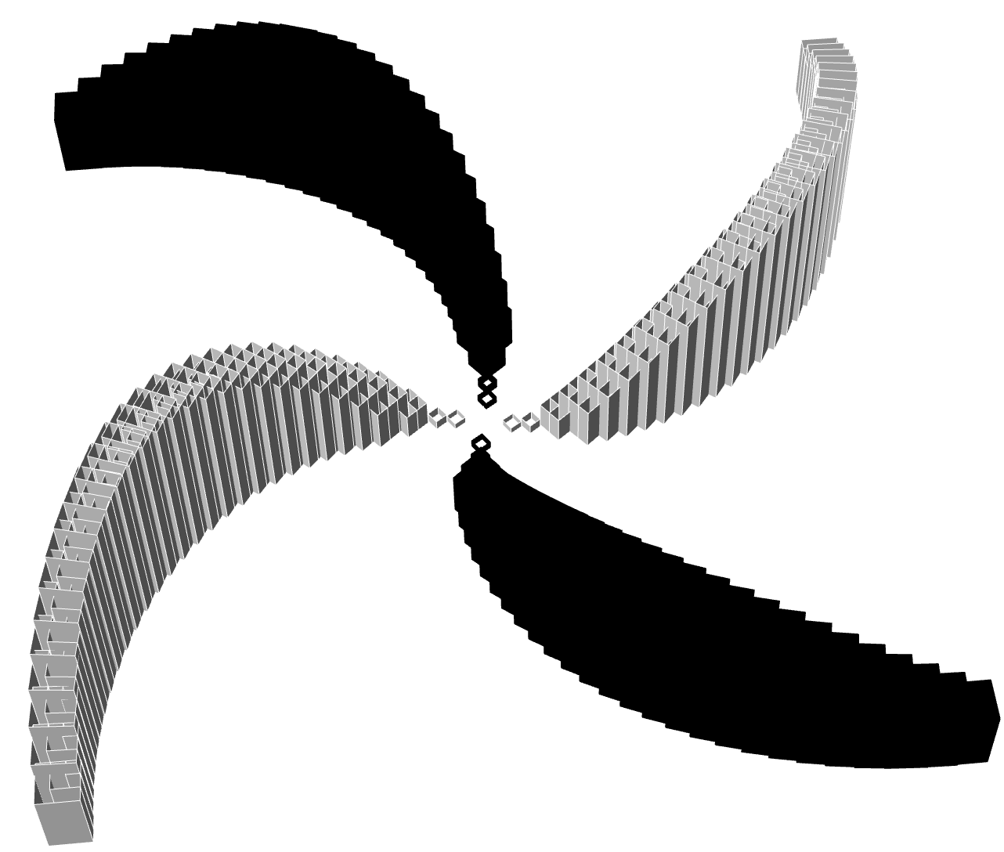
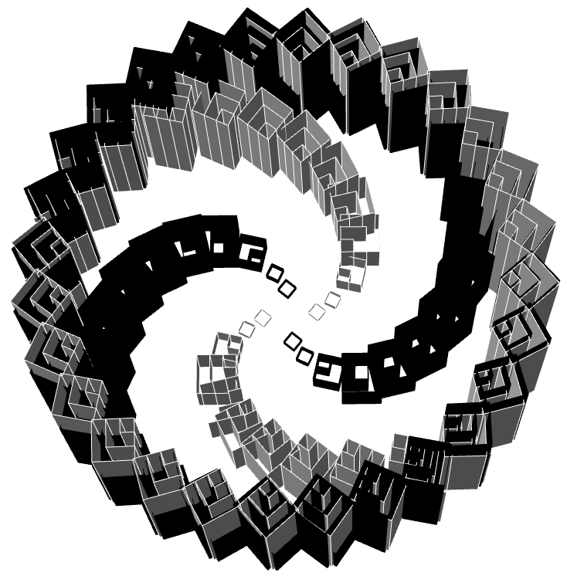
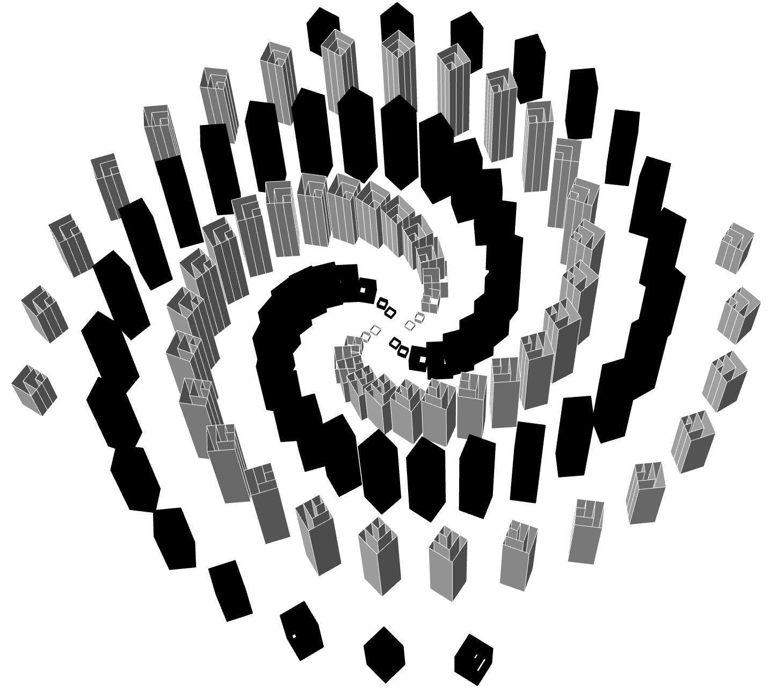
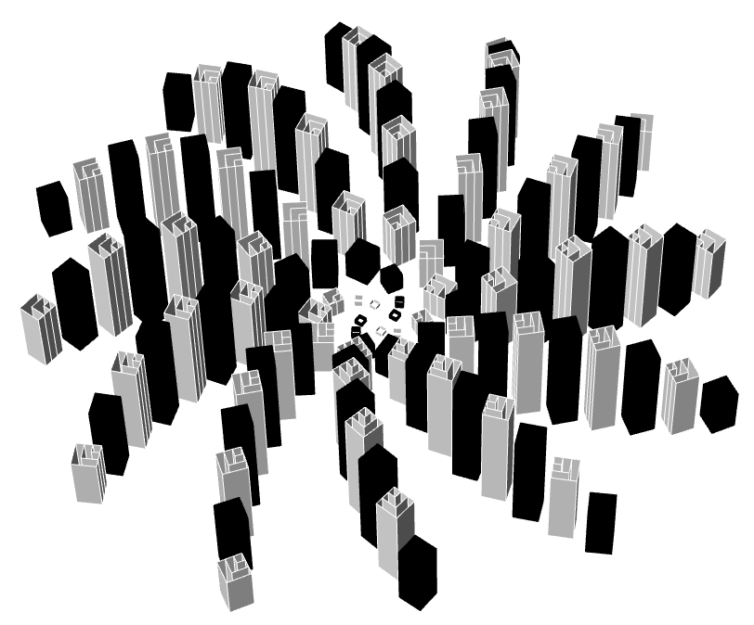
P6
<Computational Design Thinking>
<Generative Design>
P6
A = 1
B = 1
C = 3.0
A = 5
B = 1
C = 3.0
A = 12
B = 1
C = 3.0
<Variation matrices>
The below are the 3 parameters of my design and the possible variation of the shapes that can be created with the parameters.
A = Radius of the spirals
B = The number of spirals
C = Extrusion of each square to create the rippling effect
Parameter C is constant at 3.0 for all the matrices on this slide
From 1st to the 4th is the variation of just parameter A increasing with B at a constant of 1
5th and 6th is variation of parameter A increasing with B at a constant of 30
7th
8TH and 9th is a variation of parameter B increasing with parameter A at a constant of 30
A = 30
B = 1
C = 3.0
A = 1
B = 30
C = 3.0
A = 5
B = 30
C = 3.0
A = 12
B = 12
C = 3.0
A = 30
B = 12
C = 3.0
A = 30
B = 30
C = 3.0
Captions
9 Different variations
01
02
03
04
05
06
07
08
09

Slide 4
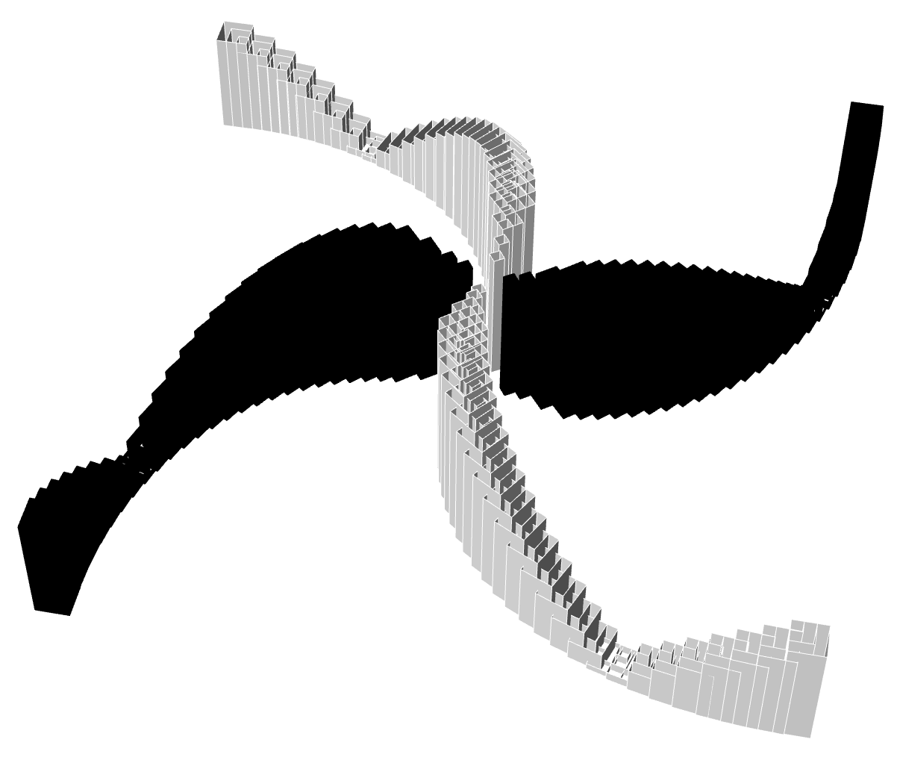
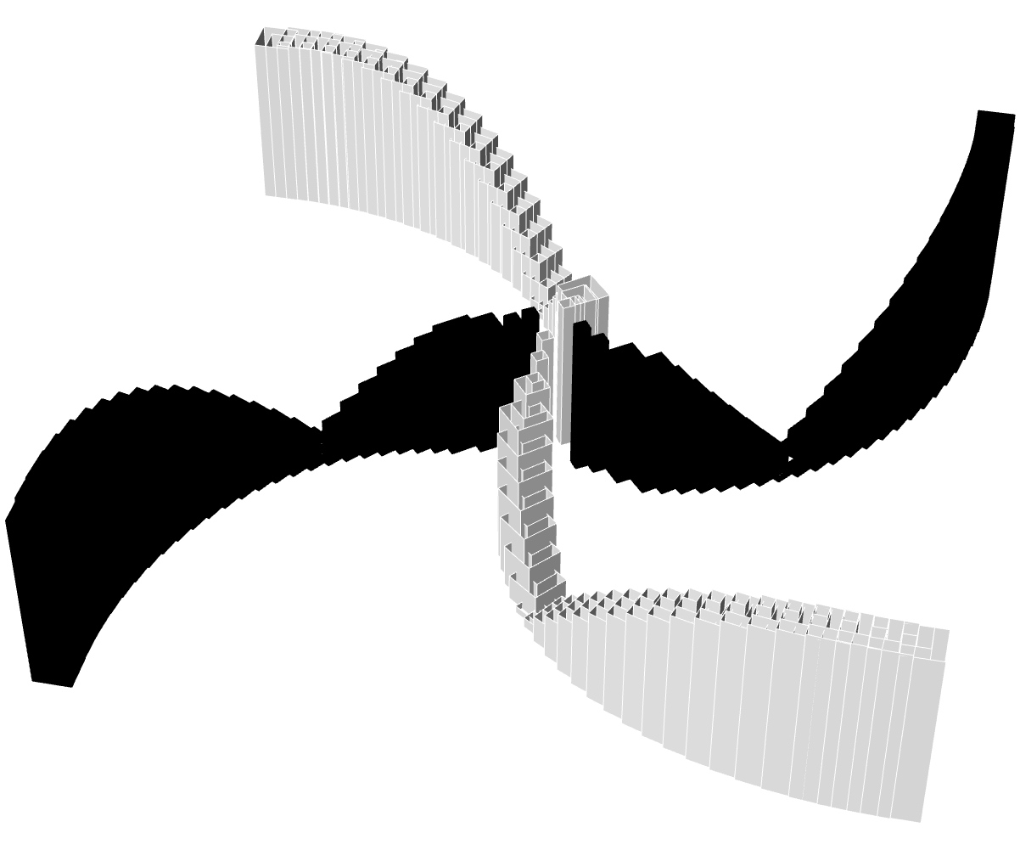
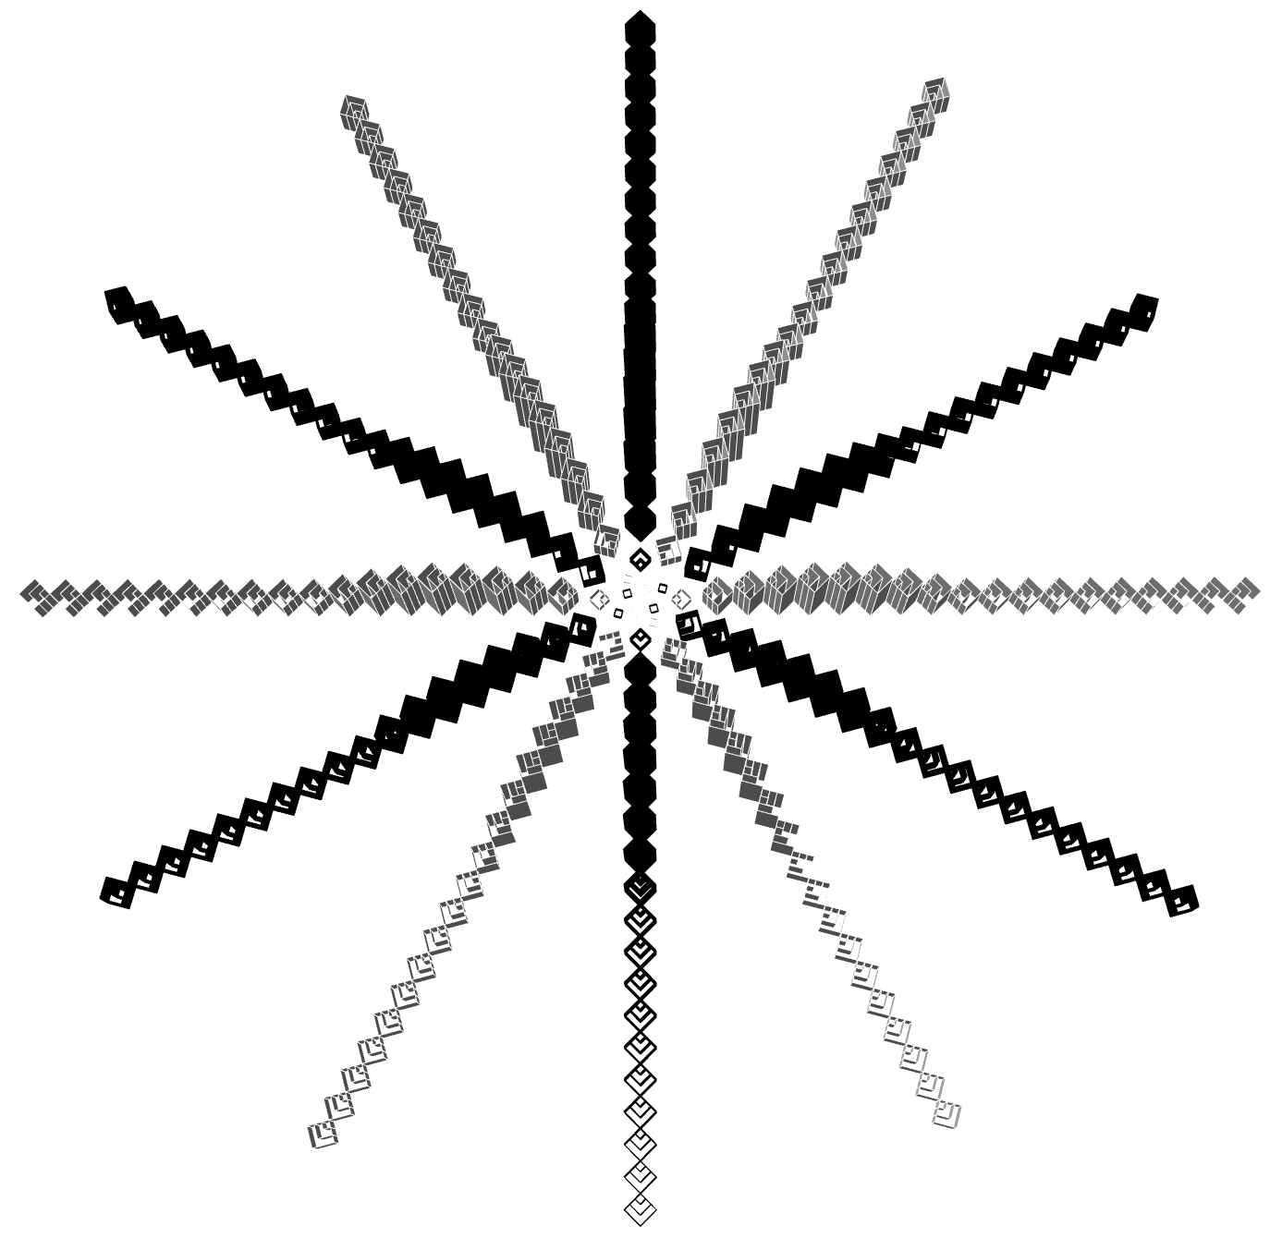
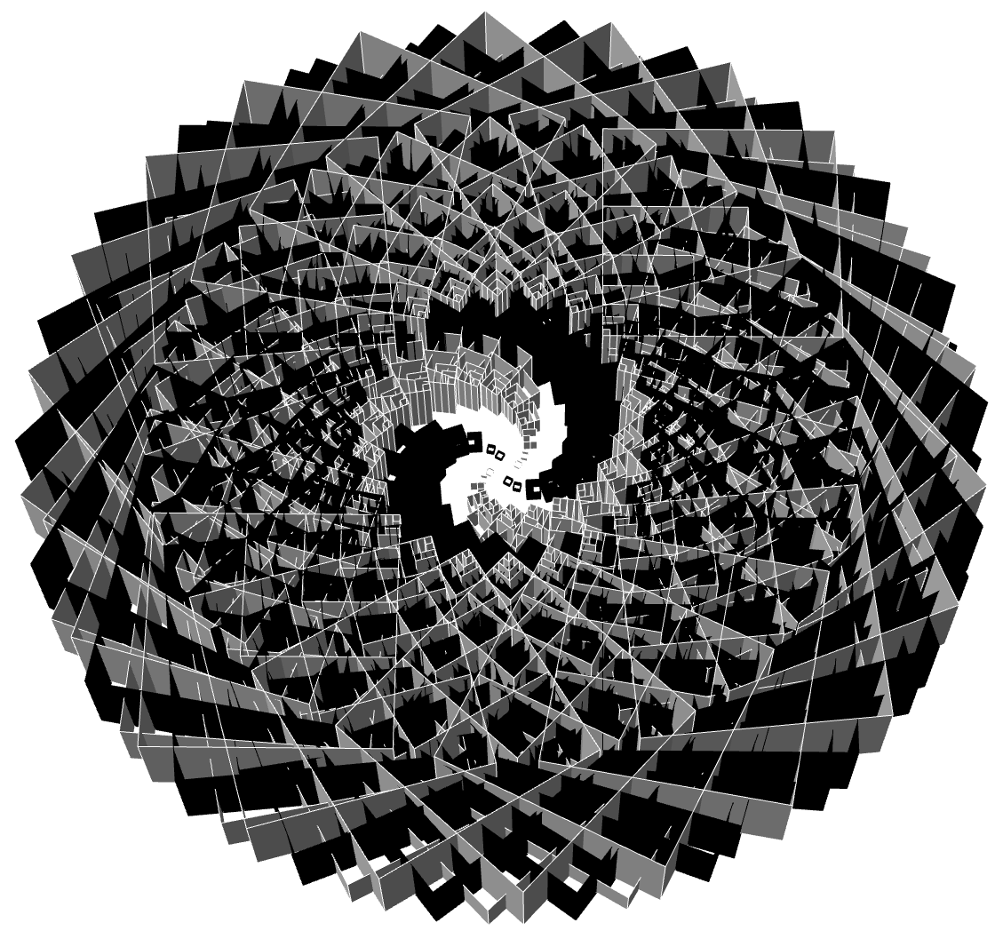
P6
<Computational Design Thinking>
<Generative Design>
P6
A = 30
B = 1
C = 1.0
A = 30
B = 1
C = 2.0
<Variation matrices part 2>
The below are the 3 parameters of my design and the variation of the shapes that can be created with the parameters
A = Radius of the spirals
B = The number of spirals
C = Extrusion of each square to create the rippling effect
The 1st and 2nd is the variation of parameter C
The 3rd and 4th are the variations that are possible when there are no limits to either the total dimension of the design or the maximum of number a squares that exist within each other respectively.
A = 59
B = 59
C = 3.0
A = 30
B = 12
C = 3.0
Captions
4 Different variations
01
02
03
04

Slide 5
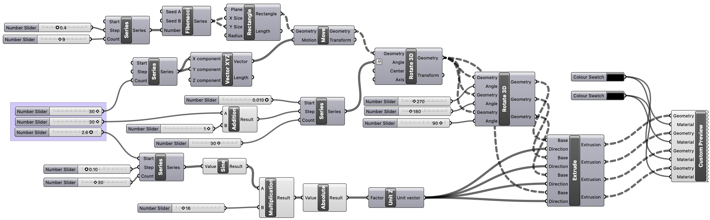
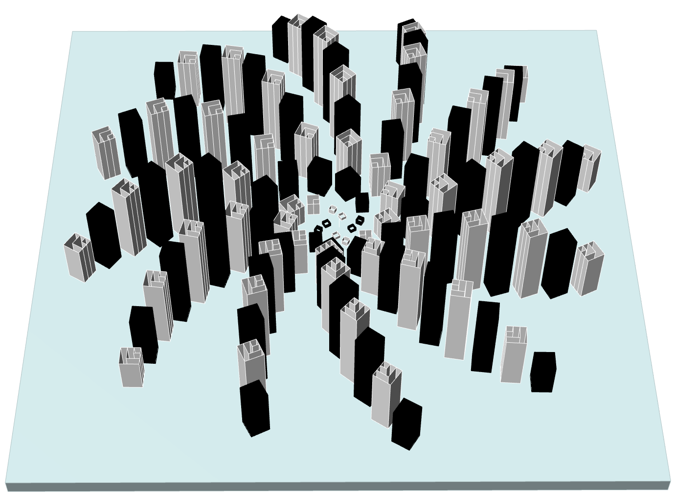
P3
<Computational Design Thinking>
<Generative Design>
P3
Initial shape derived from the Fibonacci sequence
Creating Multiple copies
Colour Function
Spiral design
Parameters of the design
Extrusion of the design
<Parametric Code Design>
The initial square shape design was derived from the Fibonacci sequence, to form squares that radiates out from the same corner with different lengths. The series function in the initial shape is to limit the pattern to have at most a maximum of 3 squares. In the spiral design, the series function help to create the golden spiral of the Fibonacci sequence. The creation of the multiple spirals is to the create the different symmetric shapes of my parametric design when each spiral are in phase at different parameters. The sine function in the extrusion of the design is to imitate the Fibonacci sequence of a rippling effect. The 3 parameters of design, the 1st controls the radius of the spirals, the 2nd controls the number of spirals, while the 3rd controls the height of the extrusion of each square to create the rippling effect.

